Slide 1
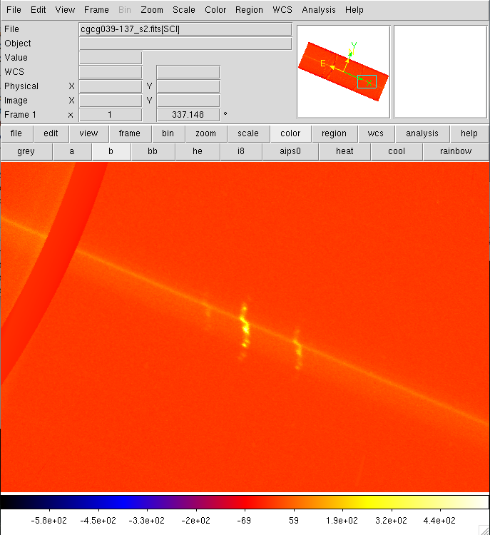
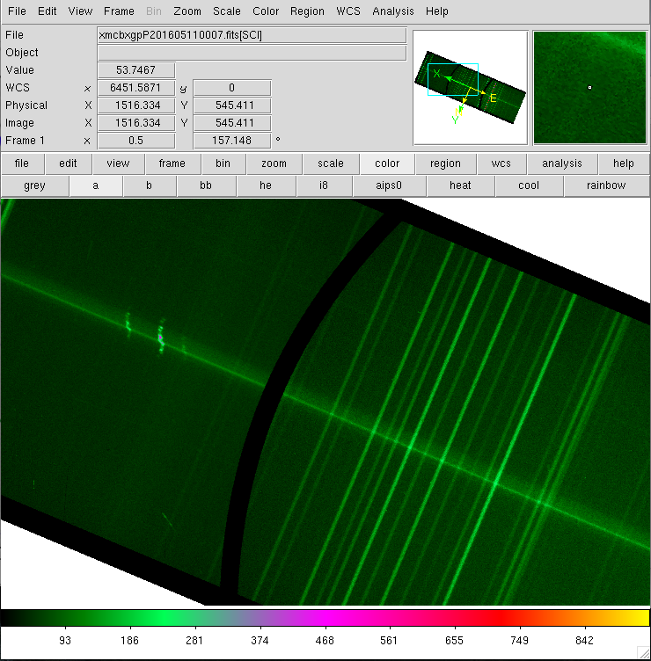
Blue side
Red side
Increasing wavelength

Slide 2
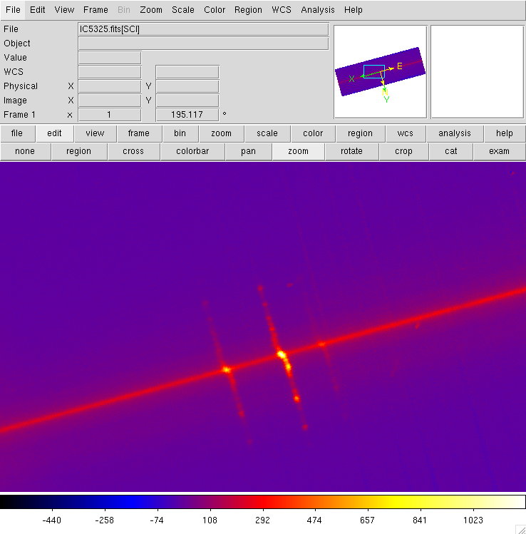
195 deg rotated
redside
Blue side
Increasing wavelength

Slide 3
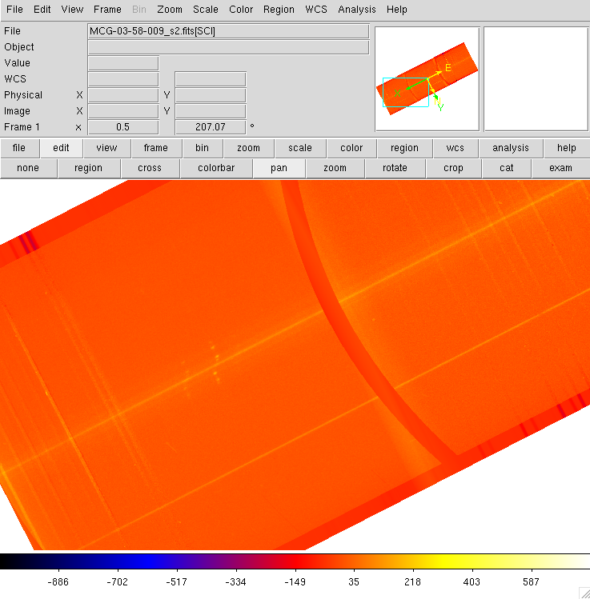

Slide 4
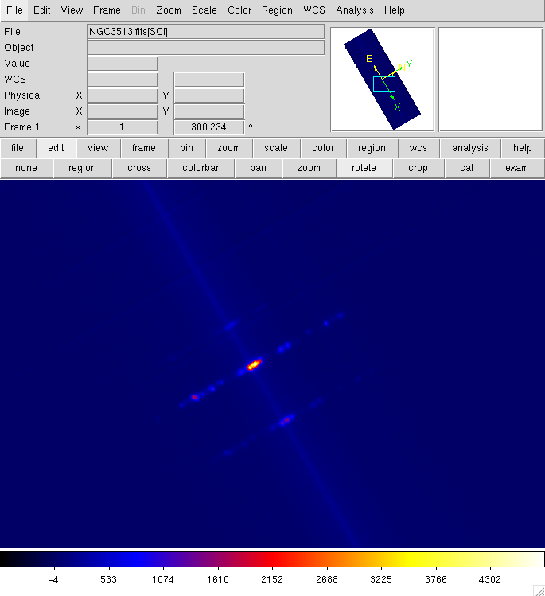
Blue side
Red side
Increasing wavelength

Slide 5
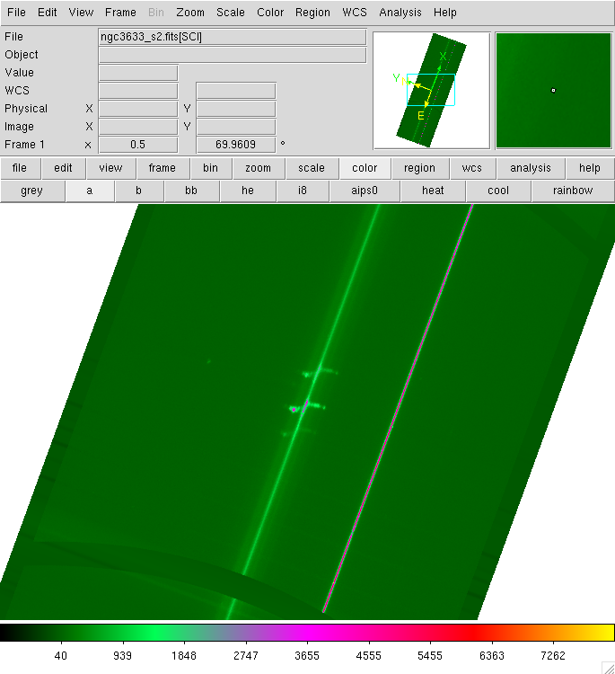
Increasing wavelength
Red side
Blue side

Slide 6
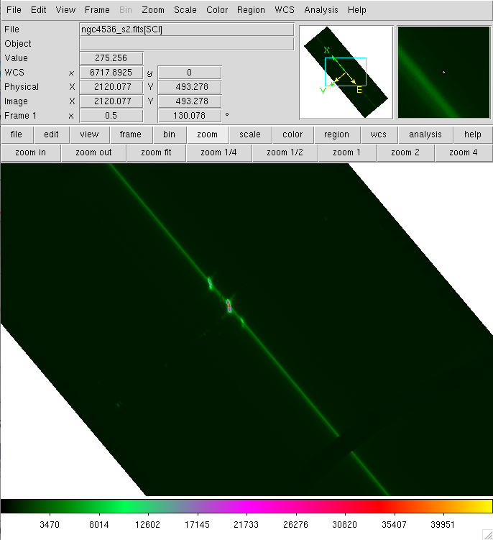
Increasing wavelength
Red side
Blue side

Slide 7
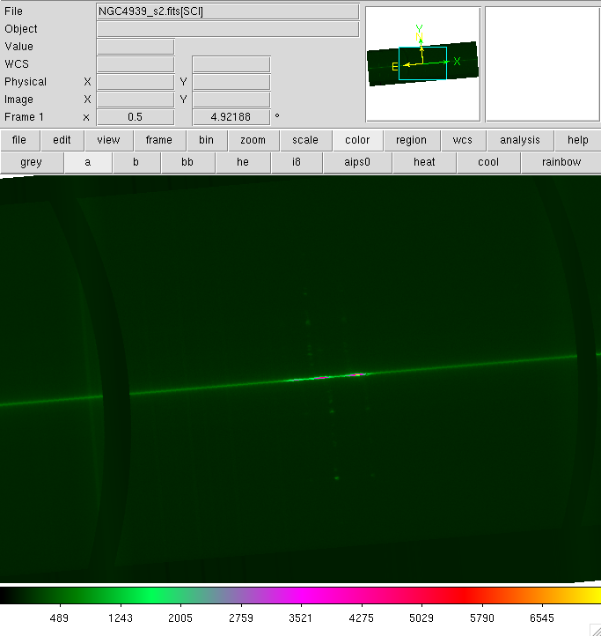
blue
red
Increasing wavelength

Slide 8
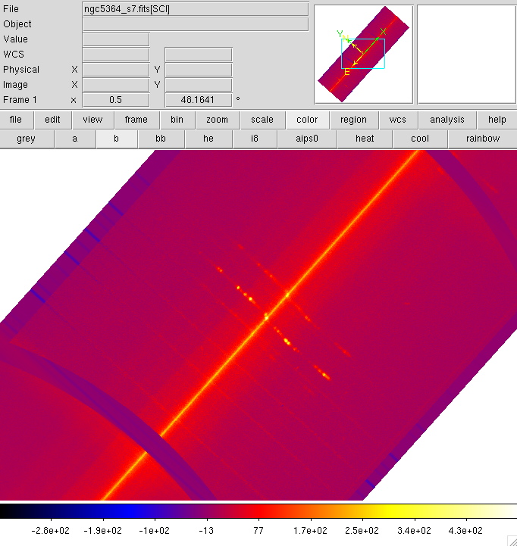
Red side
Blue side
Increasing wavelength

Slide 9
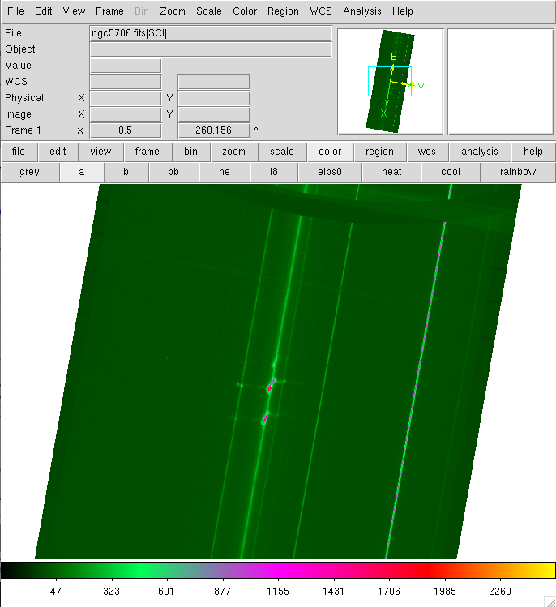
Blue side
Red side
Increasing wavelength

